Slide 1
New Member Experience: Ideation
C4SF Research Guild session on 4/6/2016
“HMW make it easier to approach teams?”
Greeters
Hospitality / Welcoming
Onboarding
Signal / Badges
“HMW make project team infos more clear to new members and facilitate project participation?”
Team and Personal Pitches
Team Details
Teams Gallery
Match / Assign
Contributors: Carla, James, Jaoyi
New members: Caitlin, David, Jersey, Tess

Slide 2
Signal / Badges
Do not disrupt sign
Designated person on team to be the representative
Picture of the project leader
Table signs
Offline connection / chat
Empty chair at group table
Color symbol for special skills needed
“Talk to me” badge
Badge for designated team member for onboarding
10.Badge for designated team member
“HMW make it easier to approach teams?”
Greeters
Matchmaker at the door
Designated brigade member who connects new members to projects
Designated brigade member to collect info from groups
Hospitality / Welcoming
Candy bowl next to the project team
Activity table with object
Open brainstorm board
Dance room
Onboarding
Allocate specific time where new members get onboarded
Create an agenda for the meetup
Require onboard protocols for each project

Slide 3
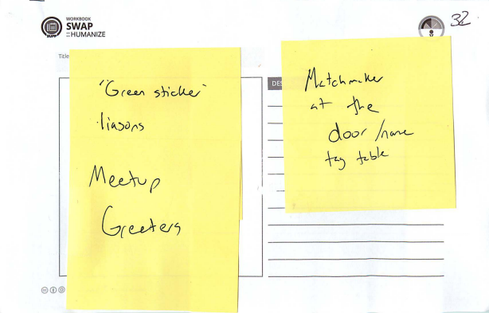
Greeters 01
Matchmaker at the door

Slide 4
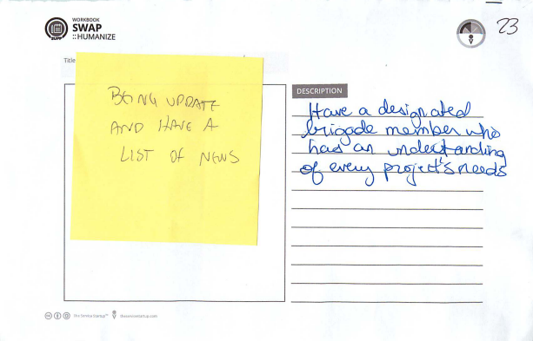
Greeters 02
Designated brigade member who connects new members to projects

Slide 5
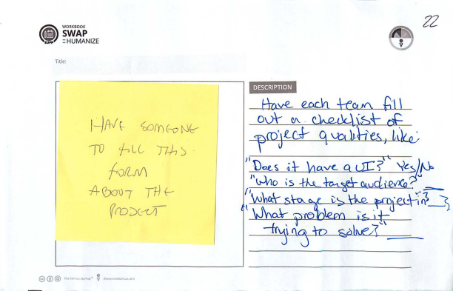
Greeters 03
Designated brigade member to collect info from groups

Slide 6
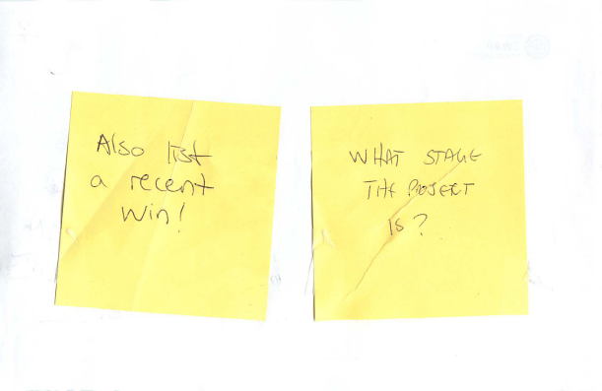
Greeters 03 - Notes

Slide 7
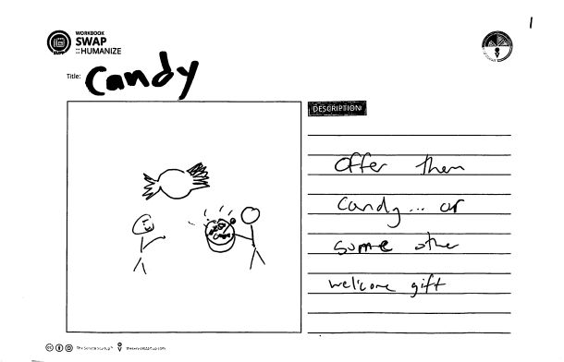
Hospitality / Welcoming 01
Candy bowl

Slide 8
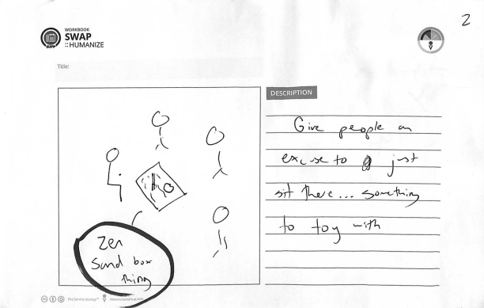
Hospitality / Welcoming 02
Activity table with object

Slide 9
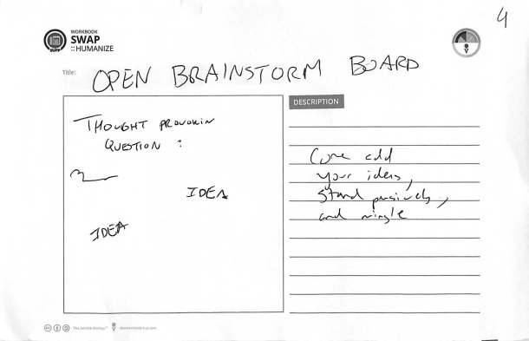
Hospitality / Welcoming 03
Open brainstorm board

Slide 10
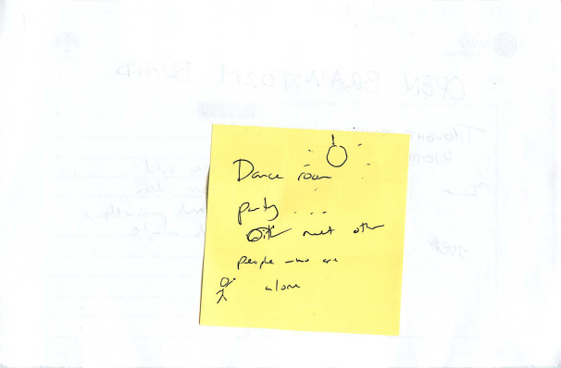
Hospitality / Welcoming 03 - Notes
Dance room

Slide 11
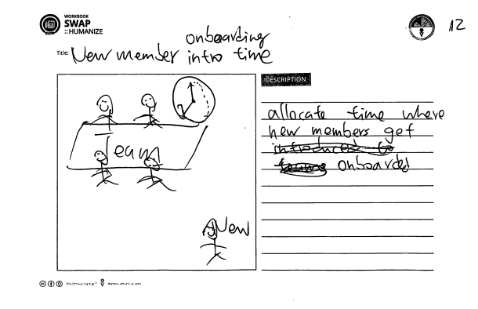
Onboarding 01
Allocate specific time where new members get onboarded

Slide 12
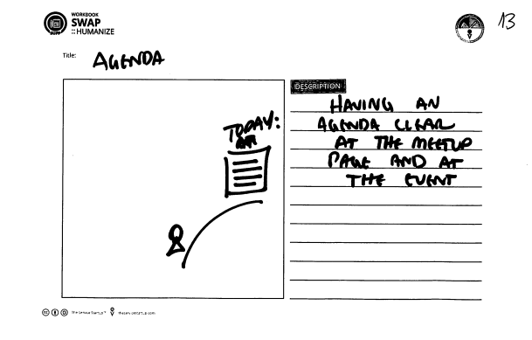
Onboarding 02
Create an agenda for the meetup

Slide 13
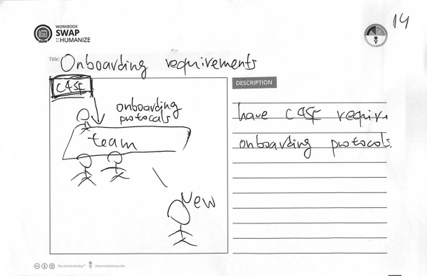
Onboarding 03
Require onboard protocols for each project

Slide 14
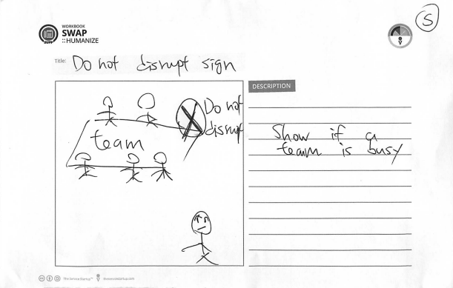
Signal / Badges 01
Do not disrupt sign

Slide 15
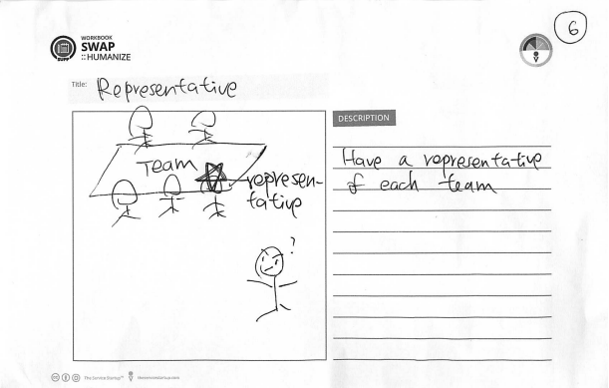
Signal / Badges 02
Designated person on team to be the representative

Slide 16
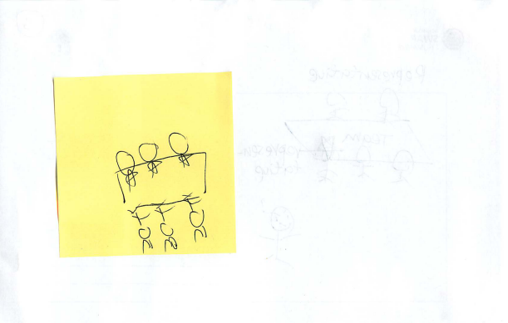
Signal / Badges 02 Note

Slide 17
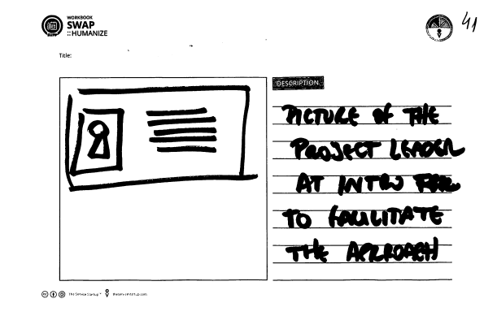
Signal / Badges 03
Picture of the project leader

Slide 18
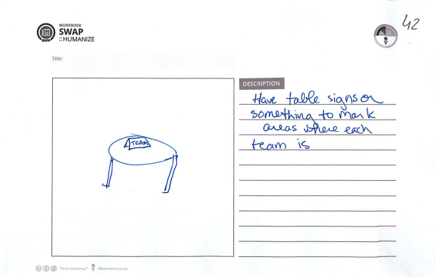
Signal / Badges 04
Table signs

Slide 19
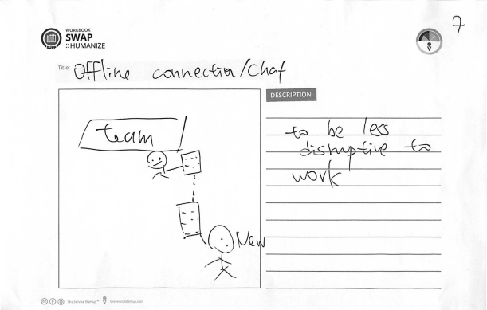
Signal / Badges 05
Offline connection / chat

Slide 20
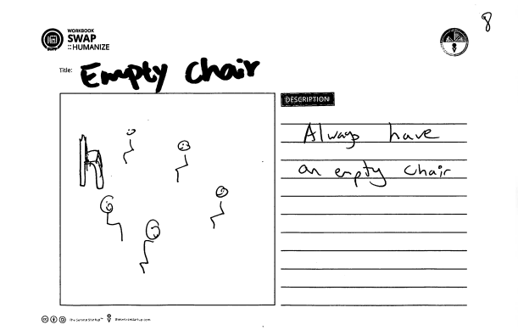
Signal / Badges 06
Empty chair at group table

Slide 21
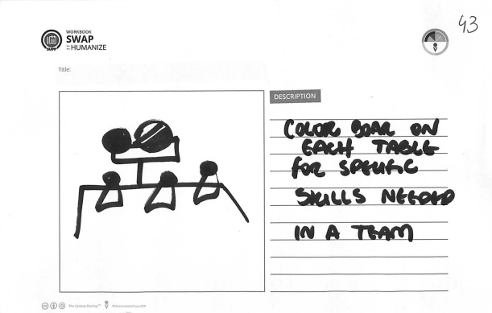
Signal / Badges 07
Color symbol for special skills needed

Slide 22
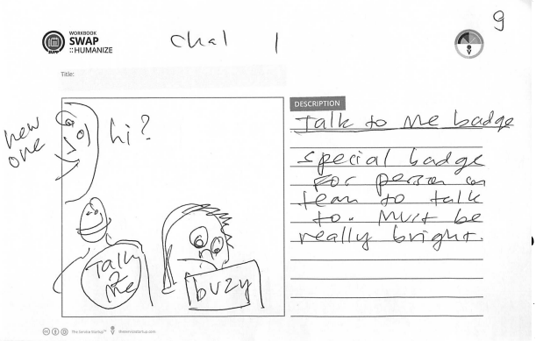
Signal / Badges 08
“Talk to me” badge

Slide 23
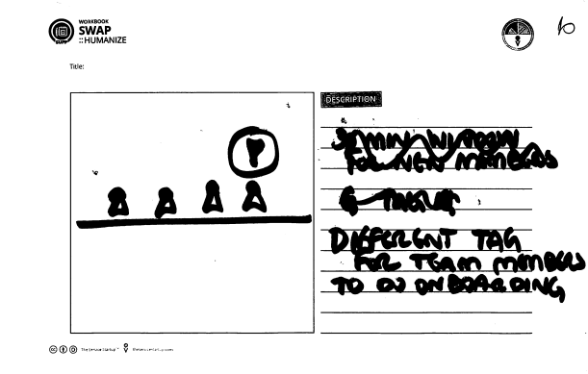
Signal / Badges 09
Badge for designated team member for onboarding

Slide 24
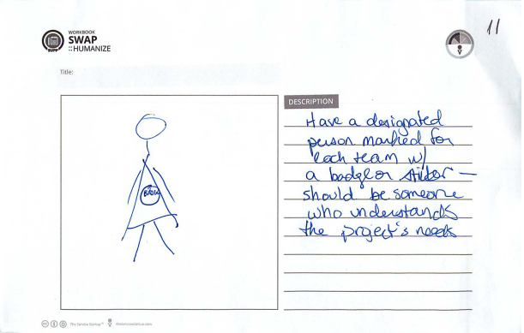
Signal / Badges 10
Badge for designated team member

Slide 25
Teams Gallery
Board of projects
Display team update on screen or poster
Posters of each team, in a gallery
“Team board” with columns for “present”, leader, slack channel, skills needed
Display screen that rotates team info
Match / Assign
Matching mechanism
New members assigned to do simple tasks
Matchmaker via the “check in”
Project filters
Speed dating, in person matchmaking
Matched to multiple projects based on skills
New members self identify, post “who needs X” questions to teams
Show new members which teams to talk to
The sorting hat decides where you should go
New members assigned to projects
Pick a team out of a hat
“HMW make project team infos more clear to new members and facilitate project participation?”
Team and Personal Pitches
New member pitches what they are passionate about
Team pitch in front of new members
Musical pitches
Team Details
Interactive screen to check in and read about teams
Nudge teams to update with visible score
Help wanted listings
Super sign, printed weekly
Up to date list of project needs
Phone app for new members to get info on teams
New member sign up, as well as teams to create a “map of teams”
Better web presence for teams
Team description on sandwich board
Pictures of leaders
Team flyer, also describes what they “don’t need”

Slide 26
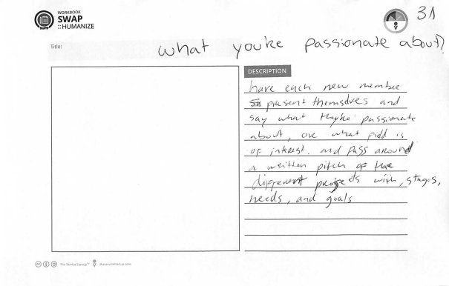
Pitches (Team or Personal) 01
New member pitches what they are passionate about

Slide 27
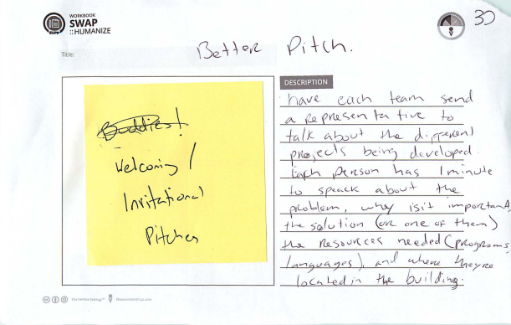
Pitches (Team or Personal) 02
Team pitch in front of new members

Slide 28
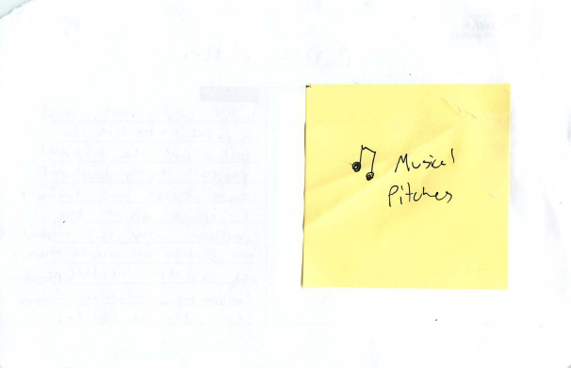
Pitches (Team or Personal) 02 Note

Slide 29
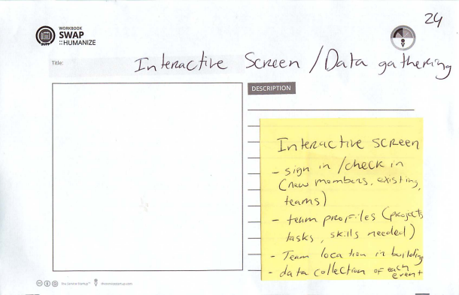
Team Details 01
Interactive screen to check in and read about teams

Slide 30
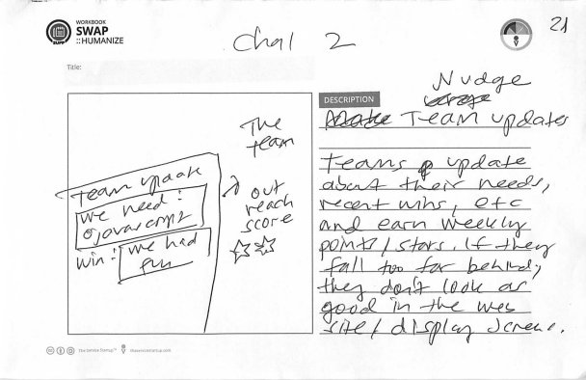
Team Details 02
Nudge teams to update with visible score

Slide 31
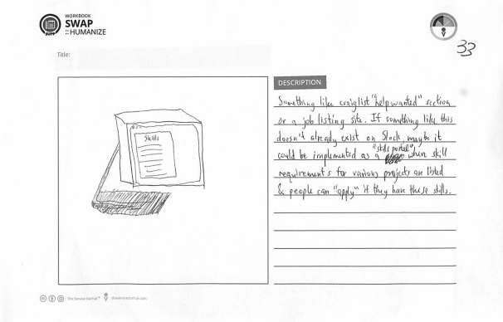
Team Details 03
Help wanted listings

Slide 32
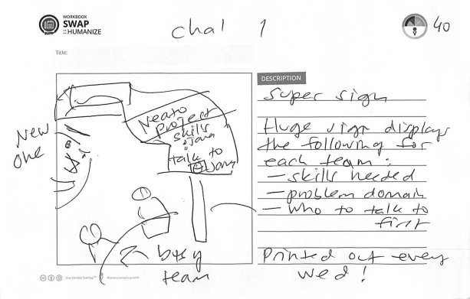
Team Details 04
Super sign, printed weekly

Slide 33
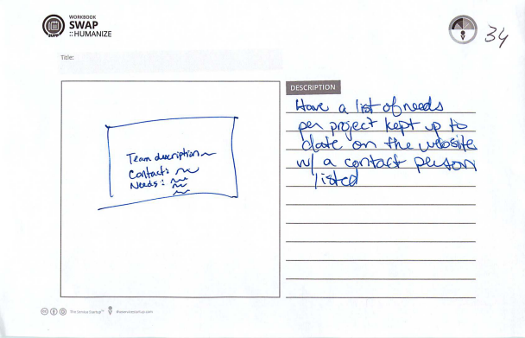
Team Details 05
Up to date list of project needs

Slide 34
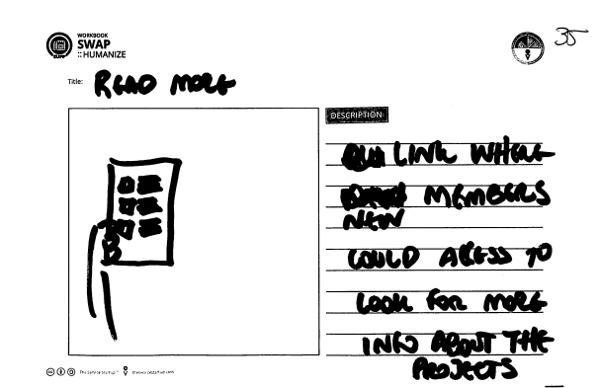
Team Details 06
Phone app for new members to get info on teams

Slide 35
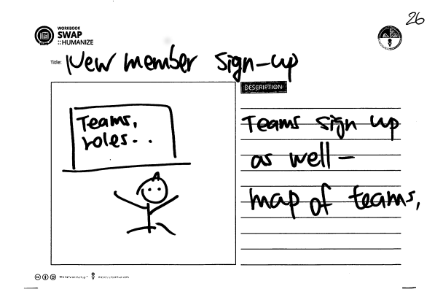
Team Details 07
New member sign up, as well as teams to create a “map of teams”

Slide 36
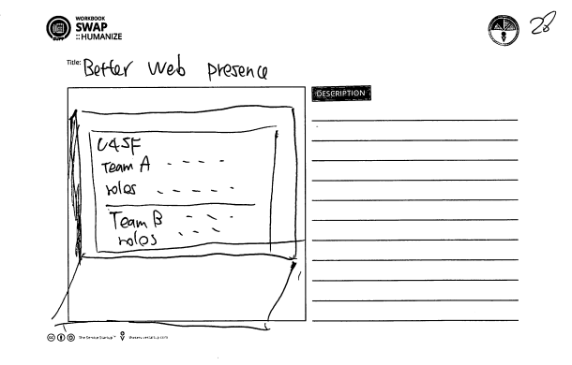
Team Details 08
Better web presence for teams

Slide 37
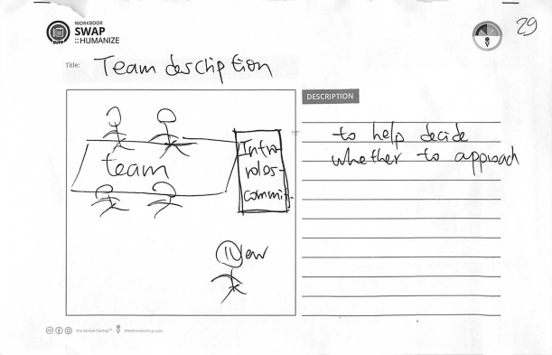
Team Details 09
Team description on sandwich board

Slide 38
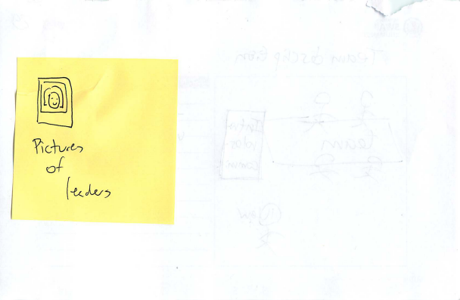
Team Details 09 Note
Pictures of leaders

Slide 39
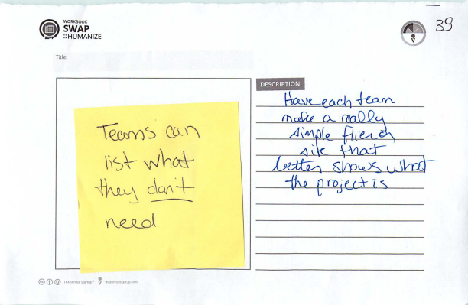
Team Details 10
Team flyer, also describes what they “don’t need”

Slide 40
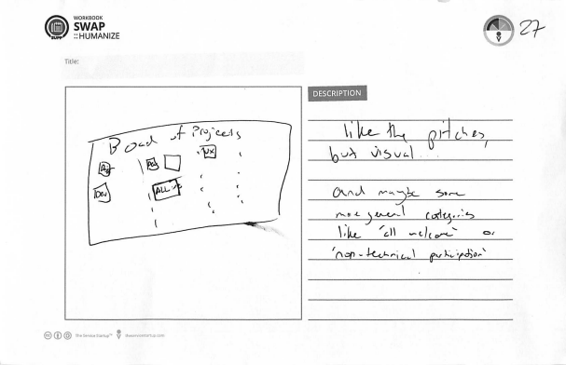
Team Gallery 01
Board of projects

Slide 41
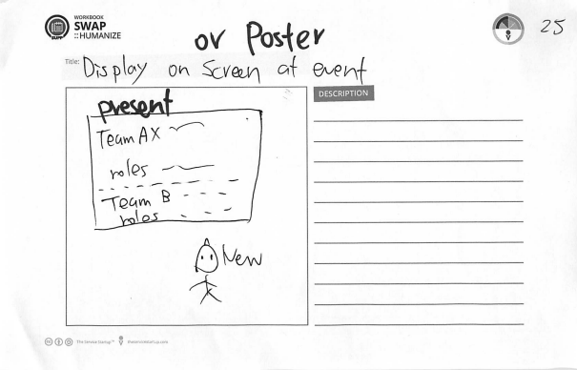
Team Gallery 02
Display team update on screen or poster

Slide 42
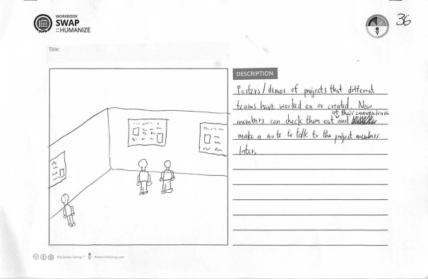
Team Gallery 03
Posters of each team, in a gallery

Slide 43
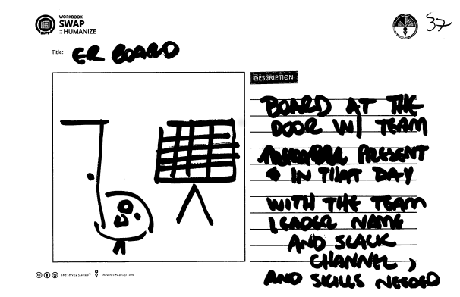
Team Gallery 04
“Team board” with columns for “present”, leader, slack channel, skills needed

Slide 44
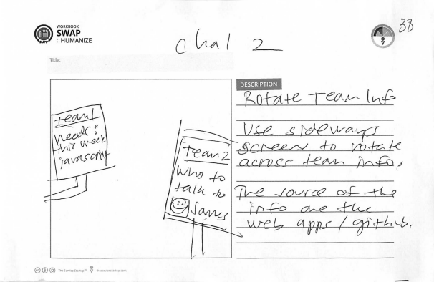
Team Gallery 05
Display screen that rotates team info

Slide 45
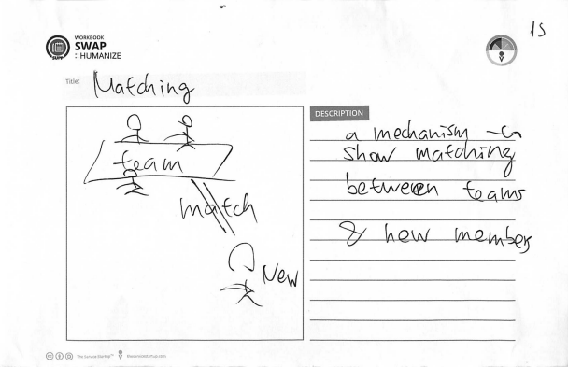
Match / Assign 01
Matching mechanism

Slide 46
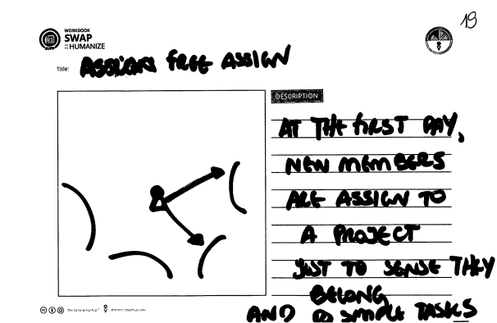
Match / Assign 02
New members assigned to do simple tasks

Slide 47
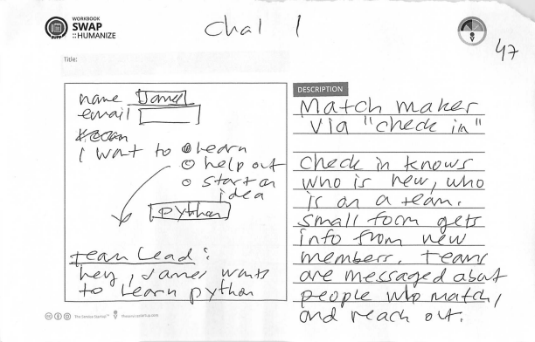
Match / Assign 03
Matchmaker via the “check in”

Slide 48
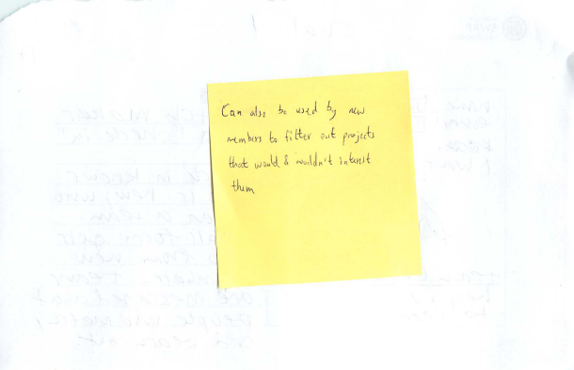
Match / Assign 04 - Notes
Project filters

Slide 49
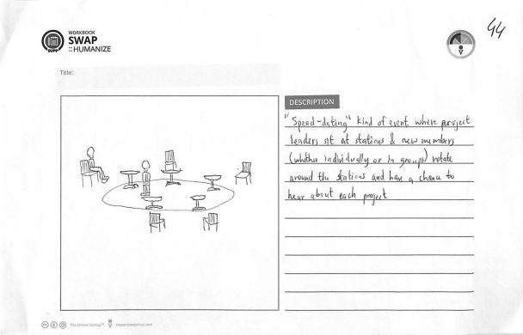
Match / Assign 05
Speed dating, in person matchmaking

Slide 50
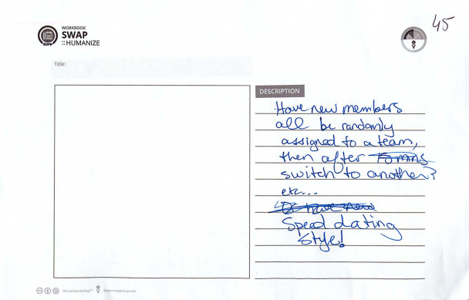
Match / Assign 06
New members randomly assigned

Slide 51
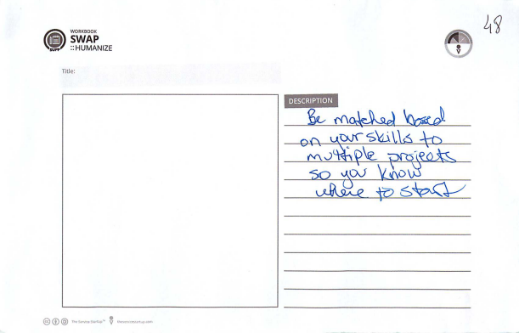
Match / Assign 07
Matched to multiple projects based on skills

Slide 52
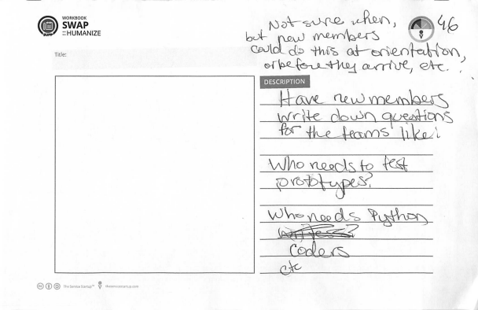
Match / Assign 08
New members self identify, post “who needs X” questions to teams

Slide 53
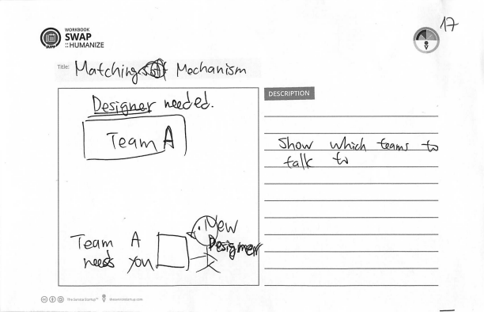
Match / Assign 09
Show new members which teams to talk to

Slide 54

Match / Assign 10
The sorting hat decides where you should go

Slide 55
Match / Assign 11
New members assigned to projects

Slide 56

Match / Assign 12
Pick a team out of a hat

